Slide 1
CST3180 WeRecycle Application
Student Name: Student Number:
Adedamola Adeniyi M00774015
Daniel Obiefule M00976304
Usman M Wakili M00808877
Alamin Shehu M00790702
Macdonald Kadzatsa M00777097
Programme:
Bsc (Hons) Information Technology
Supervisor:
Aisha Idoo

Slide 2
Table of Content
Problem Definition
User Stories
Navigational Map | Site Map
Low Fidelity – Sketches, Wireflow
Detailed Mockups
Iteration
Theoretical Justification
10 Principles in design

Slide 3
Problem Definition
Recycling is currently gaining momentum globally, but there are very few user-friendly applications that allow users to find drop-off locations. In Mauritius, this is a particular problem, as people often lack the motivation to sort and separate their trash and they also find it difficult to locate the nearest drop-off point.
Hence the need to develop a user-friendly and accurate navigation app that would help people find the closest recycling drop-off location. This app should be easy to use and provide up-to-date information on drop-off locations. It should also be accessible to people with disabilities.
We developed an interface which passed through three stages: first, we sketched the interface; next, we created a low-fidelity design on Miro; and finally, we developed the high-fidelity design and prototype on Figma.

Slide 4
User stories
I want to be able to locate recycle centers easily.
I would like to see tips about recycling.
I want the app to be easy to use and navigate, so I can quickly find the information I need without any hassle.
I want the app to provide clear directions to each drop-off location, so I can easily find my way there.
I want the app to provide information on the types of materials accepted at each drop-off location, so I can plan accordingly and avoid unnecessary trips.
I want the app to have a map view, so I can visually see the locations of recycling drop-off points in my area.

Slide 5
Navigational Model/Site Map
SIGN UP
DASHBOARD
LOG IN
ACCOUNT
PRODUCTS
RECYCLE
LOCATION
WALLET
CHANGE PASSWORD
ELECTRONICS
GLASS
PAPERS
PLASTIC
Redeem Points
CHANGE LOCATION
LOCATION

Slide 6
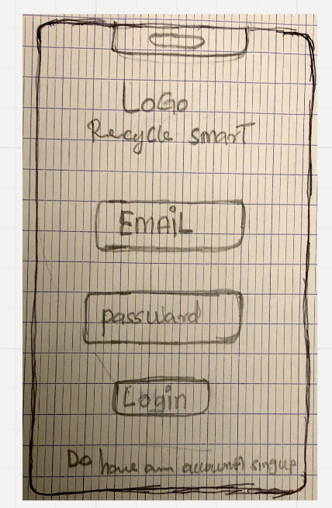
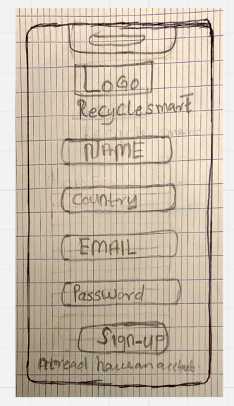
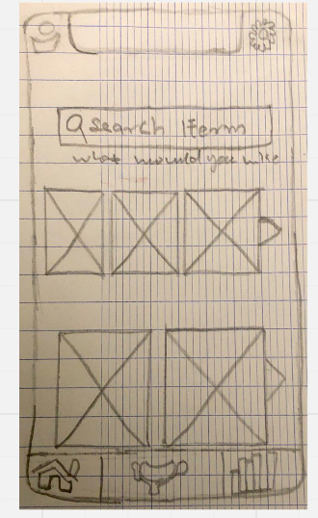
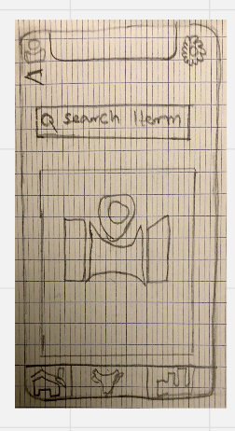
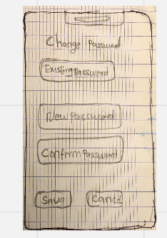
Sketches
The initial stage of our design process is illustrated below, showcasing the sketches we developed:

Slide 7
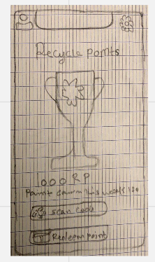
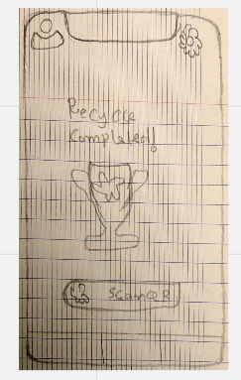
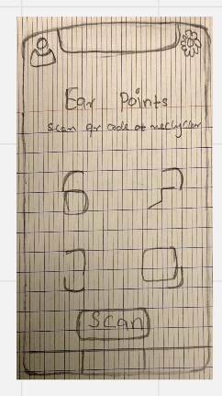
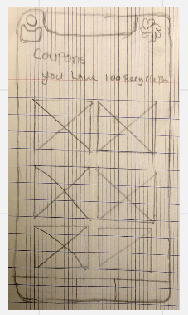
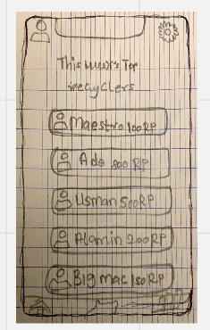
Sketches
The final depiction of our sketches are shown below:

Slide 8
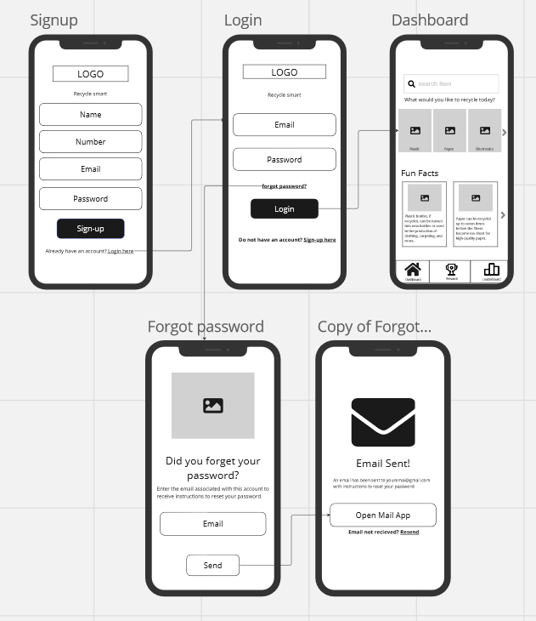
Low Fidelity Wireframes
WeRecycle Wire flow for Login/Create an account

Slide 9
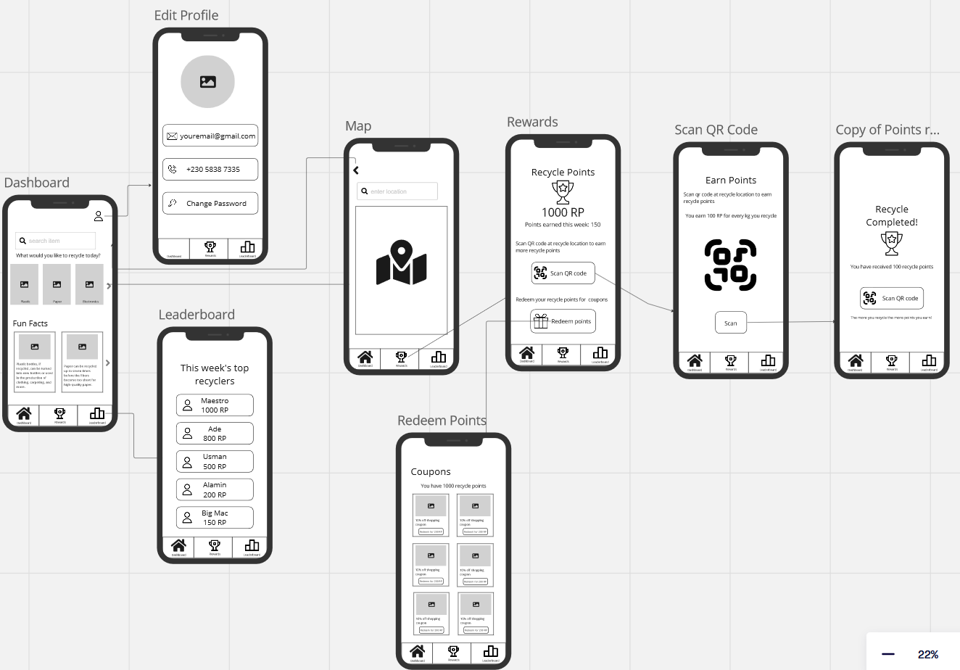
Low Fidelity Wireframes
WIRE flow from Dashboard – Edit Profile – Maps – Rewards – Scan QR Code – Leaderboard – Redeem Points
Here is the link to WeRecyle Miro Board: https://miro.com/app/board/uXjVN3Dptf0=/

Slide 10
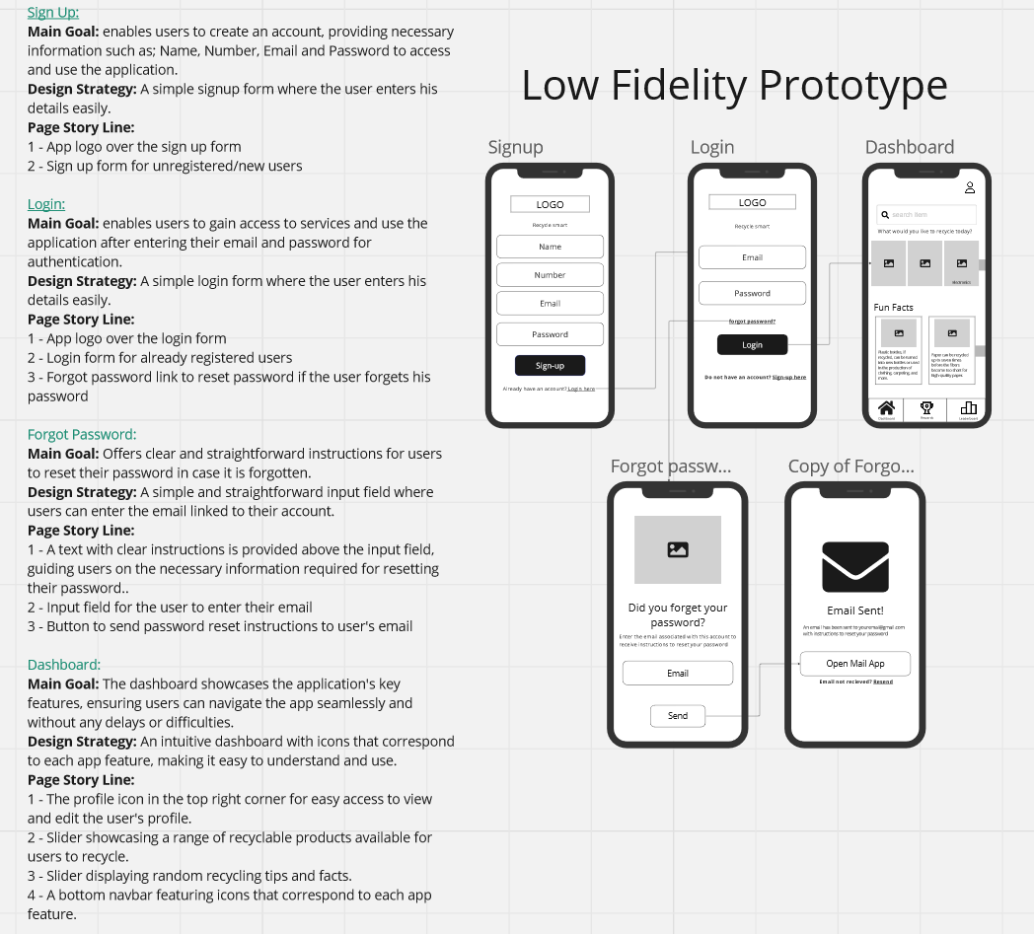
Detailed Mockups
Page storylines: Detailed mock-ups (screen shots with description)

Slide 11
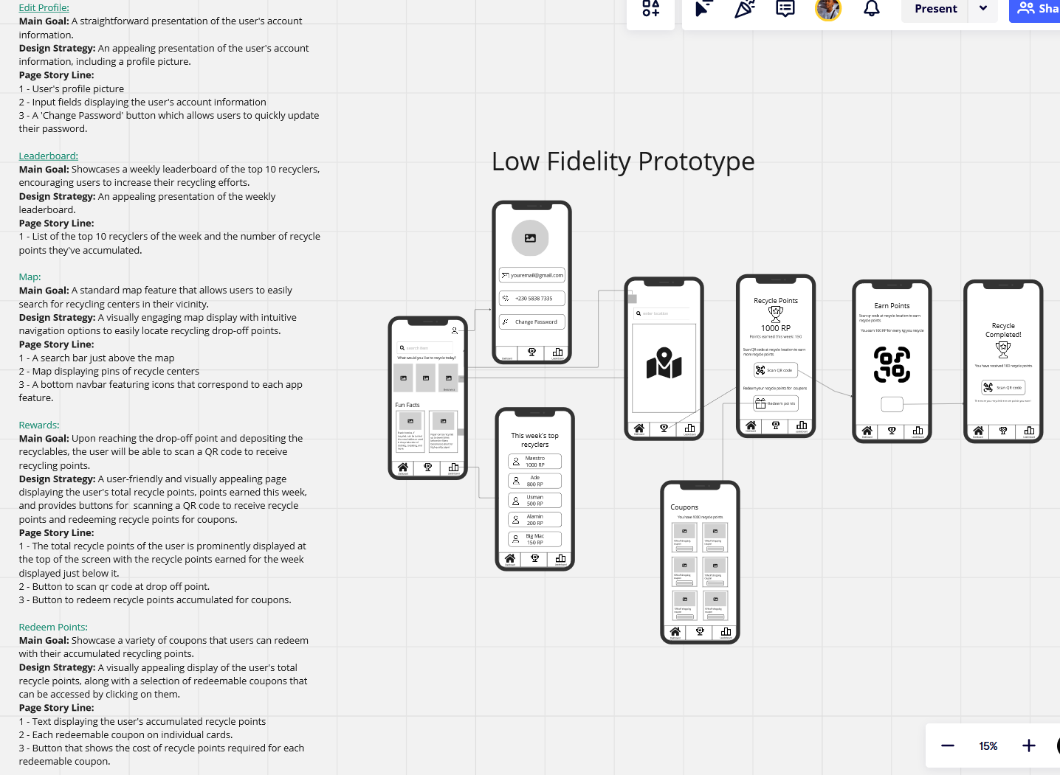
Detailed Mockups
Page storylines: Detailed mock-ups (screen shots with description) contd.
Here is the link to WeRecyle Miro Board: https://miro.com/app/board/uXjVN3Dptf0=/

Slide 12
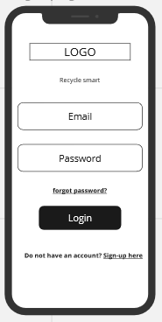
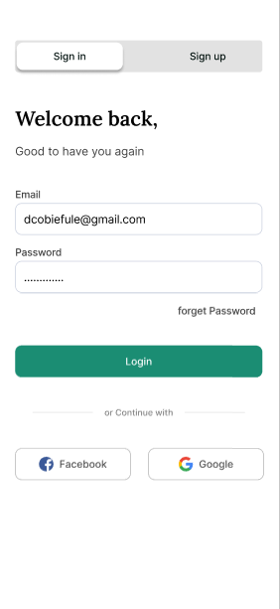
Iteration
The Design of the interface evolved over the three different phases; we want to Highlight the progression of the design over the different phases.
LOGIN PAGE
SKETCH LOW-FIDELITY HIGH-FIDELITY

Slide 13
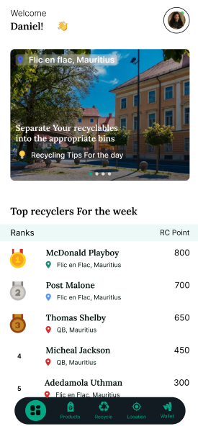
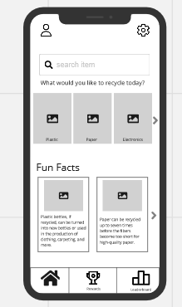
Iteration
The Design of the interface evolved over the three different phases; we want to Highlight the progression of the design over the different phases.
HOME PAGE
SKETCH LOW-FIDELITY HIGH-FIDELITY

Slide 14
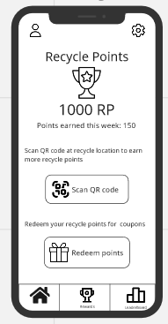
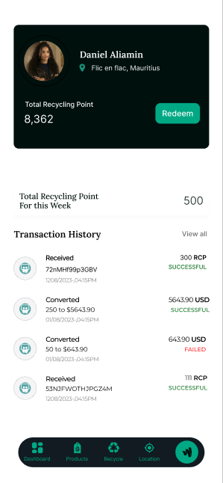
Iteration
The Design of the interface evolved over the three different phases; we want to Highlight the progression of the design over the different phases.
Recycle Points Screen
SKETCH LOW-FIDELITY HIGH-FIDELITY

Slide 15
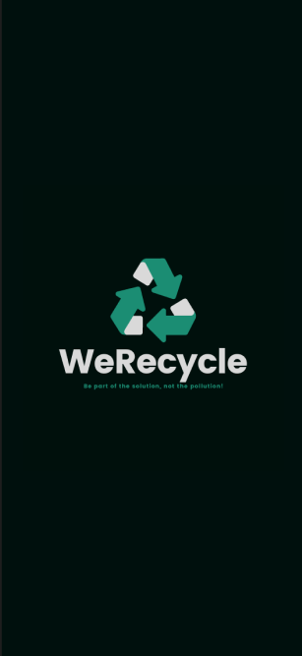
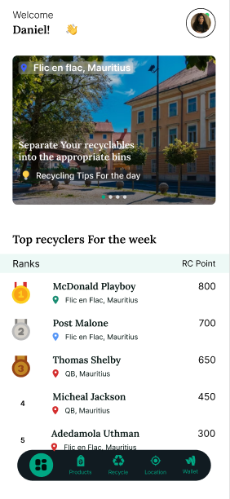
Theoretical Justifications
1. Colors
The team decided on using green and white as brand colors.
Green is often associated with nature, growth, and sustainability, making it a suitable choice for an app focused on recycling and environmental conservation. In many cultures, green is associated with environmental awareness and eco-friendliness. By using green as a primary color, the app can appeal to users who are environmentally conscious and looking for ways to reduce their carbon footprint.
While white is often used as a background color in design because it provides a high level of contrast with other colors. This can make text and other elements easier to read and navigate, improving the overall user experience.
Green and white are both colors that are generally considered to be accessible to a wide range of users, including those with color vision deficiencies. This can help ensure that the app is usable by as many people as possible.

Slide 16
Theoretical Justifications
2. Navigation Style
The team chose to put a fixed navbar at the bottom of the screen as it is the most accessible area for users' thumbs when holding a mobile device. This is known as the "thumb zone." By placing the navigation bar at the bottom, users can easily reach and interact with the navigation elements without having to stretch or adjust their grip on the device. This enhances the overall user experience by reducing physical strain and making navigation more comfortable and intuitive.
A fixed navigation bar at the bottom of the screen provides a consistent and predictable user interface. Users expect to find navigation elements at the bottom of the screen in many mobile apps, as this has become a common design pattern. By adhering to this convention, users can quickly and easily locate the navigation bar and access key features of the app without having to search or guess where they might be located. This consistency enhances usability and reduces cognitive load, as users don't have to learn a new navigation system for each app they use.

Slide 17
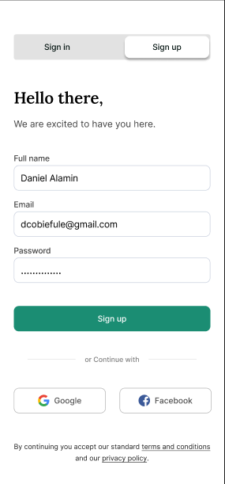
Theoretical Justifications
3. Authentication Mechanism
The design team chose to collect the user's full name, email, and password for sign-up to ensure a comprehensive and secure authentication process. By collecting the full name, the app can personalize user experiences and communications, fostering a sense of belonging and trust. The email serves as a unique identifier and a means of communication, while the password ensures account security. This approach aligns with the principle of least privilege, as it only collects the necessary information for account creation.
For returning users, the design team opted for a simplified authentication mechanism, requiring only the user's email and password. This decision was made to enhance user experience by reducing friction during the login process. By eliminating the need to re-enter the full name, the app streamlines the login experience, making it more efficient and user-friendly. This approach also aligns with the principle of simplicity, as it minimizes the number of steps required for returning users to access the app.

Slide 18
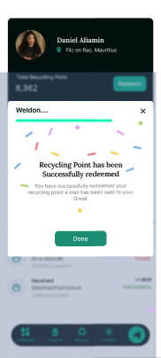
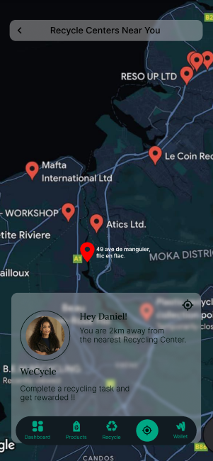
10 principles implementing Nielsen and Molich’s UI Design Guidelines
Visibility of System Status
Match Between System and Real World
Successful Message
A clear message notifying the use that their recycle points have been successfully redeemed.
System and Real World
A clear depiction of a real world map, allowing the user to know that the desired recycle point has been accurately identified

Slide 19
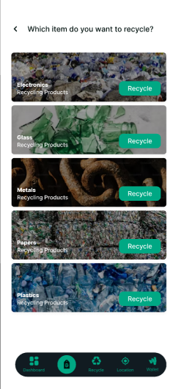
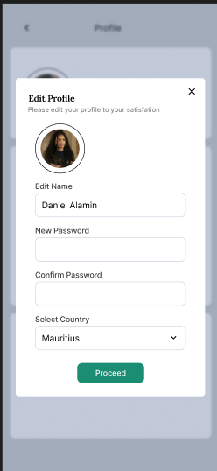
10 principles implementing Nielsen and Molich’s UI Design Guidelines
User Control and Freedom
User Control and Freedom
User Control
The “<” icon ensures that the user can return to the previous page easily at any time.
User Control
The “x” icon ensures that the user can cancel the process at anytime.

Slide 20
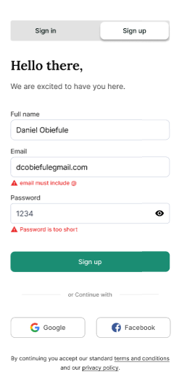
10 principles implementing Nielsen and Molich’s UI Design Guidelines
Consistency and Standard
Error Prevention
Consistency & Standard
The same icons were consistently used to represent each specific feature across all pages.
Error Prevention
A clear message guiding users on the correct information to input during the signup process

Slide 21
10 principles implementing Nielsen and Molich’s UI Design Guidelines
Recognition Rather Than Recall
Flexibility and Efficiency of Use
Recognition
Each icon is associated with the name so that users can easily recognize and understand the meaning of those icons when they see them.
Flexibility and Efficiency
Experienced and inexperienced users can navigate through the application easily through the navbar. With the functions of each icons specified.

Slide 22
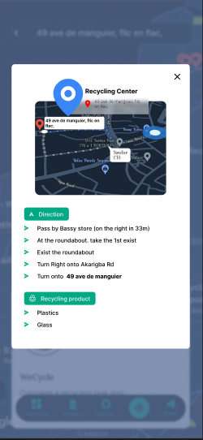
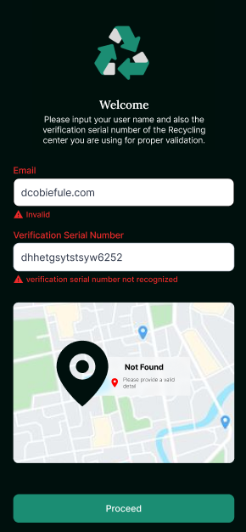
10 principles implementing Nielsen and Molich’s UI Design Guidelines
Aesthetic and Minimalist Design
Help Users Reg, Diag and
Rec from Errors
Minimalist Design
Only required and relevant information is displayed to the user.
Recover From Errors
Errors are designed using human-readable language to ensure that users understand the error and know how to resolve it.

Slide 23
10 principles implementing Nielsen and Molich’s UI Design Guidelines
Help and Documentation
Documentation
Provide users with various recycling tips daily
Here is the link to WeRecycle Figma Designs: https://www.figma.com/file/bcbOfe60fmQu3JUCFDC5Ah/Recycling-UI-Design?type=design&node-id=153-6534&mode=design&t=IlbCl8mzqSNbymnA-0

Slide 24
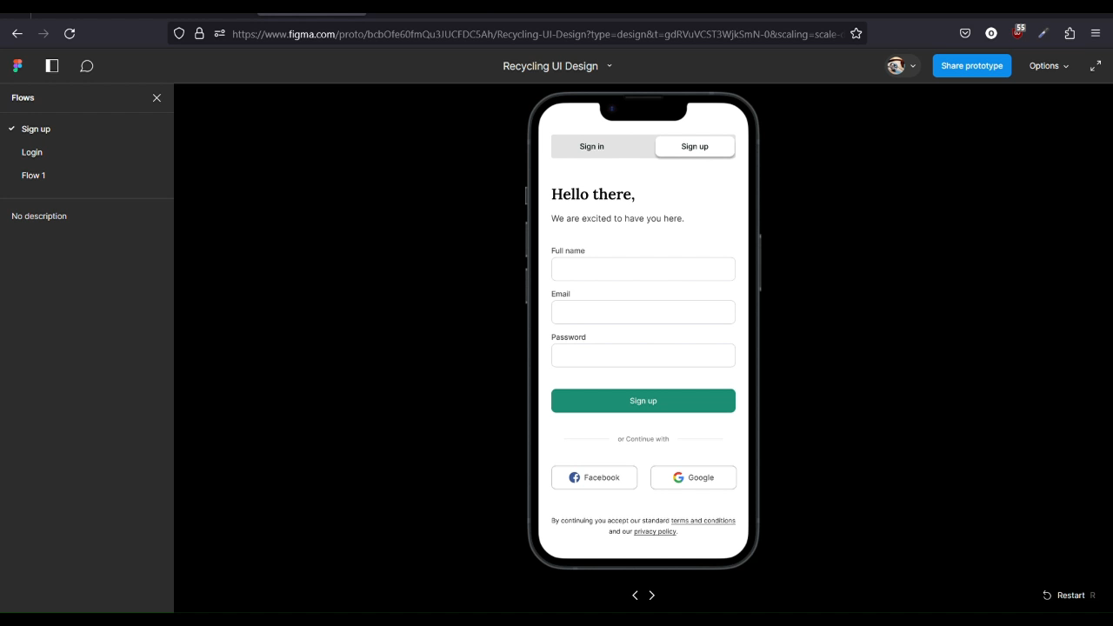
Figma Prototype (Video)
Here is the link to WeRecycle Figma Designs: https://www.figma.com/file/bcbOfe60fmQu3JUCFDC5Ah/Recycling-UI-Design?type=design&node-id=153-6534&mode=design&t=IlbCl8mzqSNbymnA-0

Slide 25
What Went Well & What To Improve On
What Went Well
The sketches and low-fidelity wireframes provided a strong foundation for our high-fidelity designs, streamlining the design process to a significant extent.
Each team member efficiently completed their assigned tasks on time.
Limitations
Due to varying levels of design expertise within the team, the completion of the designs was not as swift as desired.
The high-fidelity designs took longer than expected due to disagreements among the team regarding the wireframes to be chosen for the final version, leading to delays.
Improvements
Establish a clear process for selecting wireframes for the final version. This could involve setting specific criteria or holding team discussions to reach a consensus. This will help avoid disagreements and delays in the future.
Encourage team members to continue learning and improving their design skills. This will help ensure that each member of the team is equipped to handle future design challenges more efficiently.
Thank You!

